Slide 1

Smart Plant
Module
Ranajoy Dutta

Slide 2
Contents
Title | Page
Introduction | 3
Hardware Required | 4
Description | 5
DHT-11 Sensor | 6
Technical Parameters of DHT-11 | 7
GPS Expansion | 8
Technical parameters of GPS Expansion | 9
Circuit Diagram | 10
Software Installation in Omega | 11
Software Installation in Server | 12
Running the system | 13

Slide 3
Smart Plant
Smart Plant is an automated system to monitor the moisture level of soil.
The system provides the moisture level of soil in percentage. This data can be further used for various purposes like automated irrigation system, study of soil and plant, plant monitoring at home to irrigate them automatically.
The moisture level is displayed on the OLED expansion screen and in terminal as well.

Slide 4
Hardware requirements
Onion Omega 2+
Expansion Dock
Wires
Soil Moisture Sensor
OLED expansion (not compulsory)
Power Supply

Slide 5
Description
We are going to build a system that uses sensor to measure the moisture level of soil.
The moisture level is measured using soil moisture sensor which returns the approximate moisture levels.

Slide 6
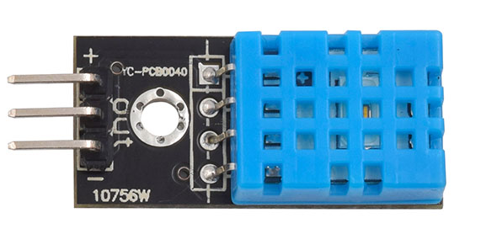
DHT-11 Sensor
The DHT11 is a basic, ultra low-cost digital temperature and humidity sensor. It uses a capacitive humidity sensor and a thermistor to measure the surrounding air, and spits out a digital signal on the data pin. It generates calibrated digital output. Its fairly simple to use, but requires careful timing to grab data. It may take upto 2 minutes to provide the output.

Slide 7
Technical Details
Electrical Parameters | HC-SR04 Ultrasonic Module
Operating Voltage | DC-3.3V or 5V
Operating Current | 0.5-2.5 mA
Sampling interval | 1 Sec
Measurement range | 20-95%RH；0-50℃
Accuracy(Humidity) | ± 5%
Accuracy(Temperature) | ± 2°C
Notes:
https://www.itead.cc/wiki/DHT11_Humidity_Temperature_Sensor_Brick

Slide 8
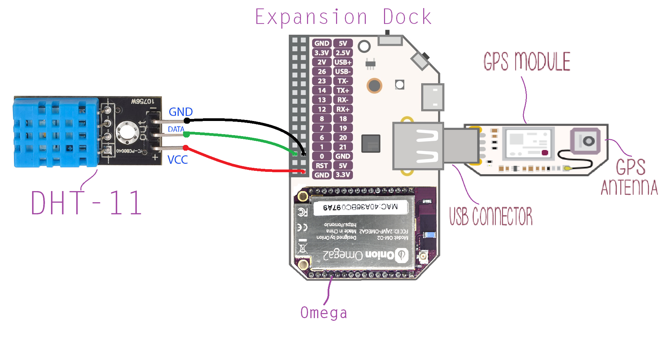
Circuit Diagram

Slide 9
Software installations in Omega
Follow this link for first time setup of Omega - https://docs.onion.io/omega2-docs/first-time-setup.html
Once you are ready, type the following commands :-
opkg update
opkg install python pyOnionGpio
opkg install python-pip
pip install paho-mqtt
Opkg install dht-sensor
Download the sender.py file from https://github.com/ranajoy-dutta/IoT-MQTT.git

Slide 10
Software installations in Server/Your system
**Currently, we are creating our system as a Server. We can also host this server file over cloud service providers like AWS (that supports python and web socket).**
Install Python3 on your system - https://www.python.org/downloads/ (Make sure you have set environment variable for python.)
Create a folder ‘weather_station’ and access it using CMD.
Run command –
pip install flask flask-mqtt flask-socketio eventlet
Clone the required files from github - https://github.com/ranajoy-dutta/IoT-MQTT.git
Open the cloned folder, copy all its files to your ‘weather_station’ folder. You can access the database file using ‘sqlite browser’.

Slide 11
Thank You !
Contact US
Nitin Sinha
nitin.sinha@goSigmaWay.com
+1 727-394-4375
+91 7838188809
Debjani Mitra
debjani.mitra@goSigmaWay.com
+1 952-583-3449
+91 9339555636
Ranajoy Dutta
ranajoydutta7@gmail.com
+91 9971807197

